Slide 1

Why is GitHub Important?
Dr Li-Ta Hsu and Dr Weisong Wen
Assisted by
Man Hei CHENG (Melvin),
Miss Hiu Yi HO (Queenie),
Miss Yan Tung LEUNG (Nikki)

Slide 2

What is GitHub?

Slide 3

What is Github?
A social network and platform for software developers
Over 65 million users
A place to Share, Communicate, Collaborate with others, especially programmers

Slide 4
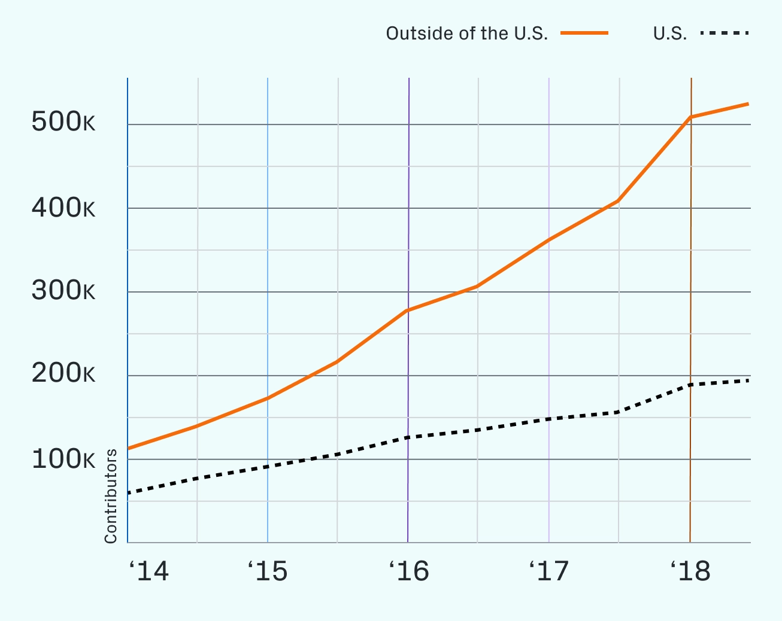
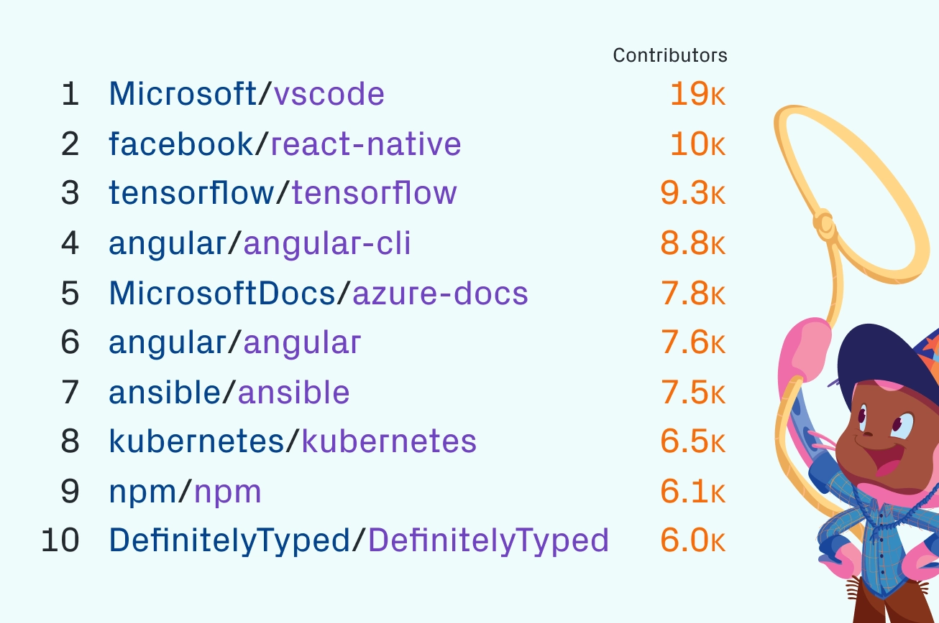
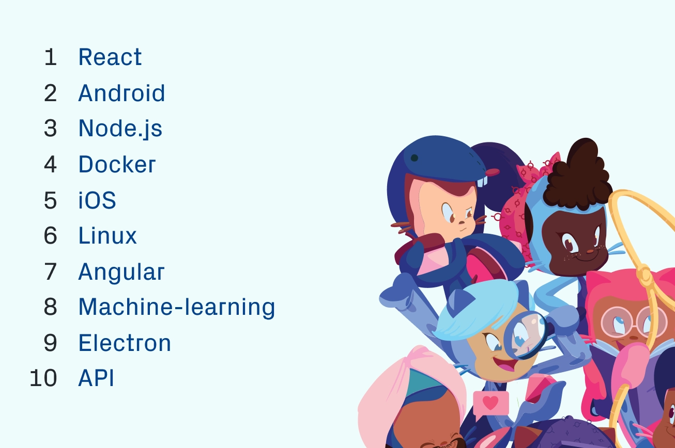
What’s on GitHub
Variety of GitHub
Over 100 million live Projects
New projects increasing over the years
Showing the trend of using GitHub for Software development
Countless topics and projects available for the public
Encompassing most popular topics nowadays

Slide 5
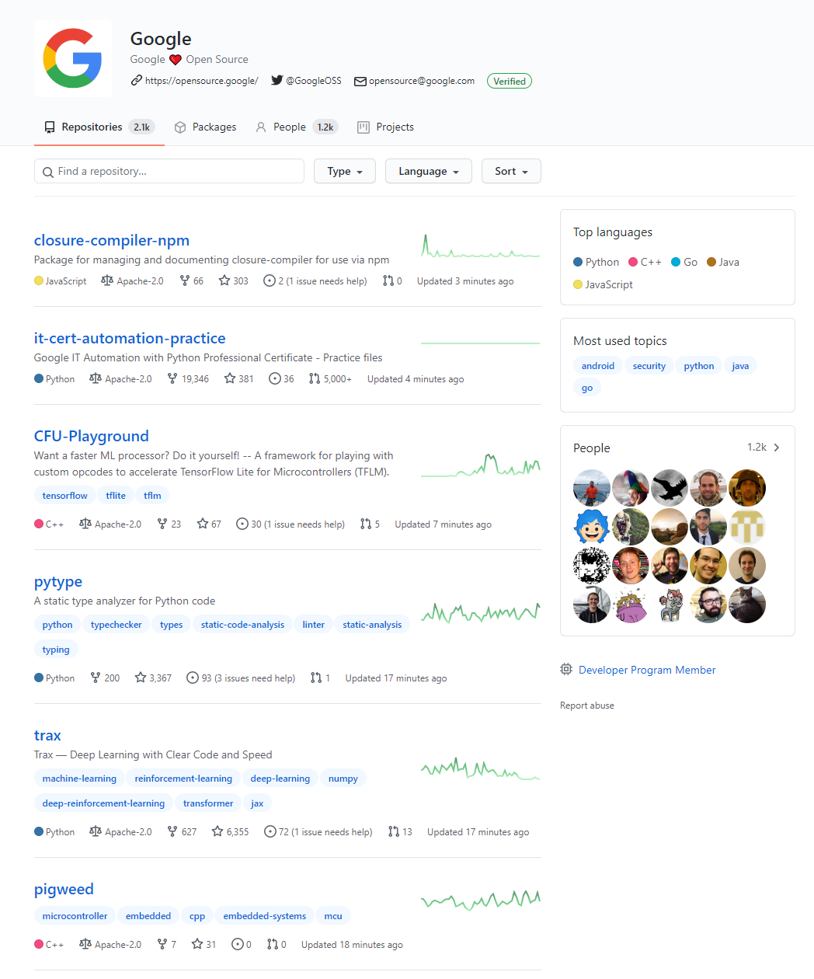
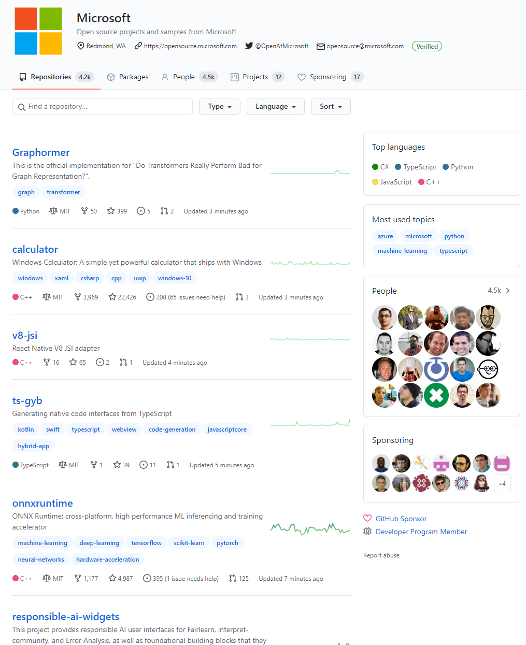
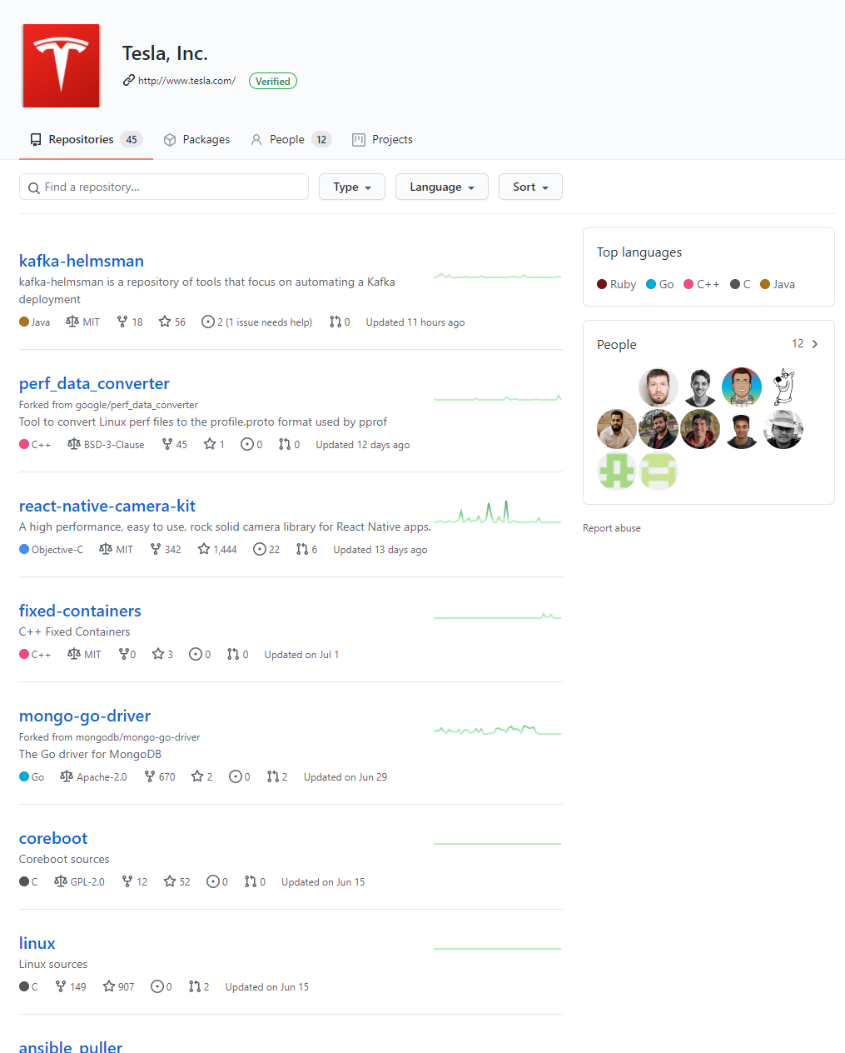
BIG GitHub Pages

Slide 6
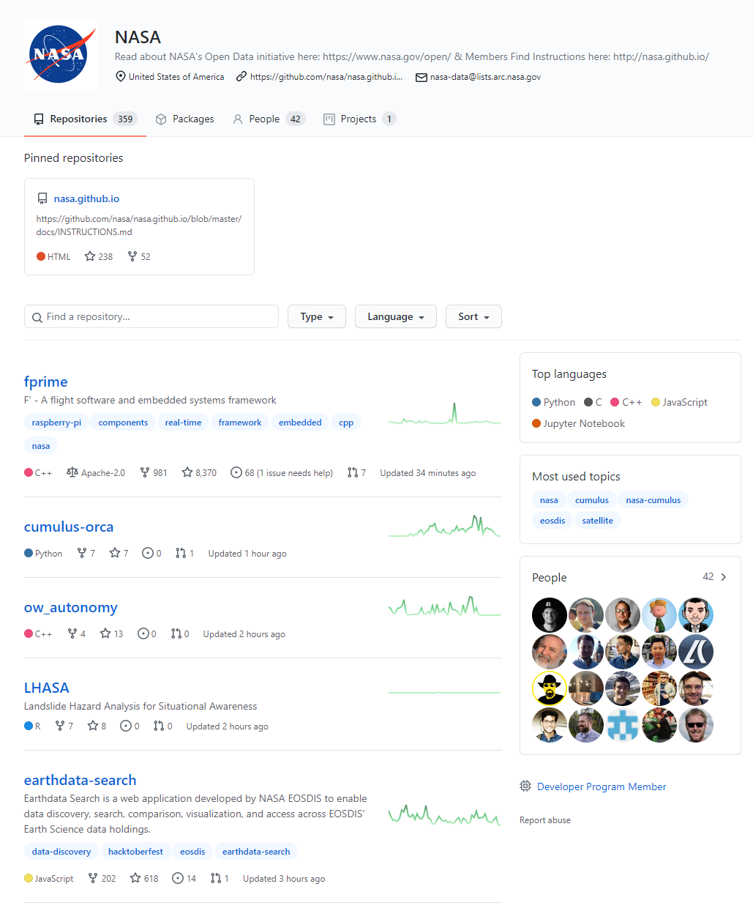
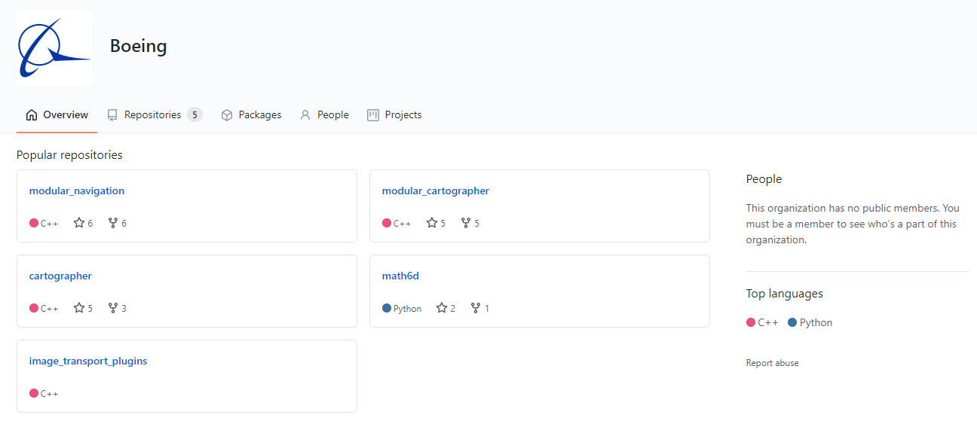
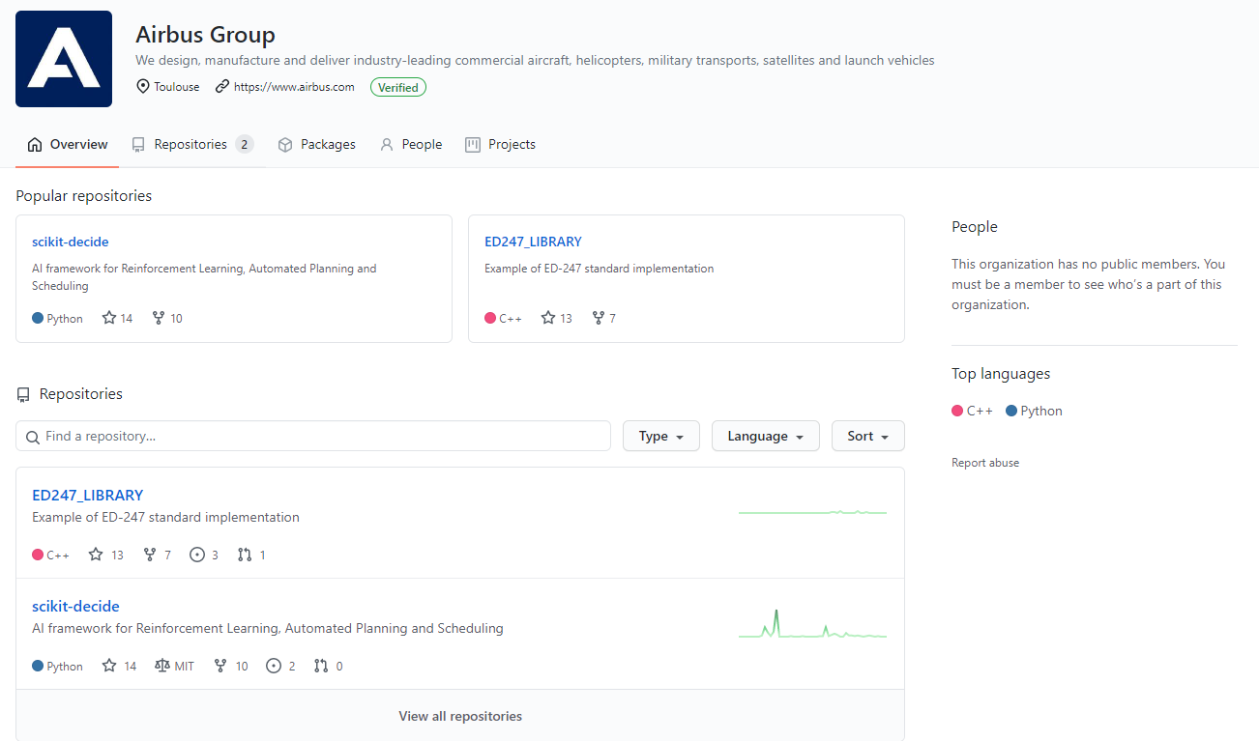
BIG GitHub Pages

Slide 7
What’s on GitHub?
How is it related to AAE?

Slide 8
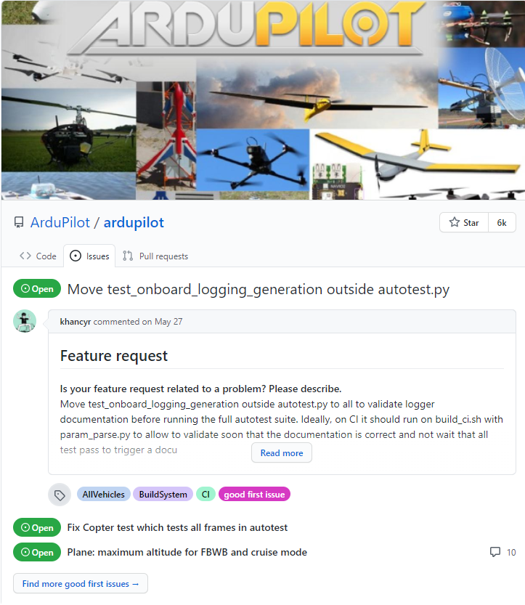
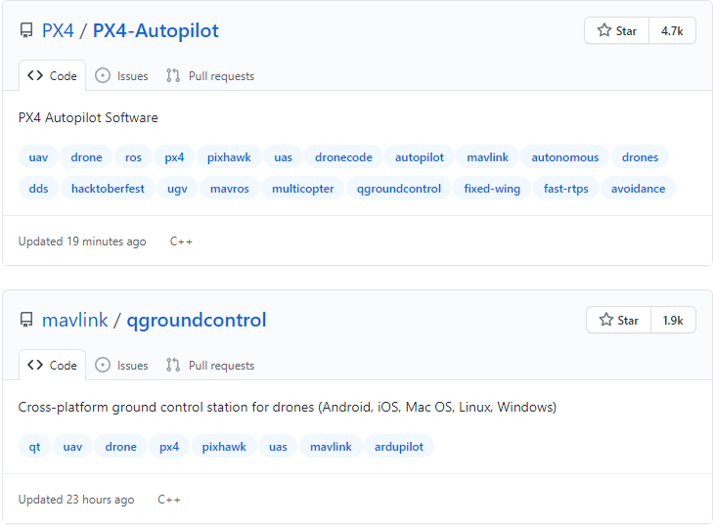
Flight control softwares for UAV
Ardupilot, PX4 and more

Slide 9
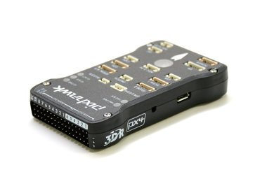
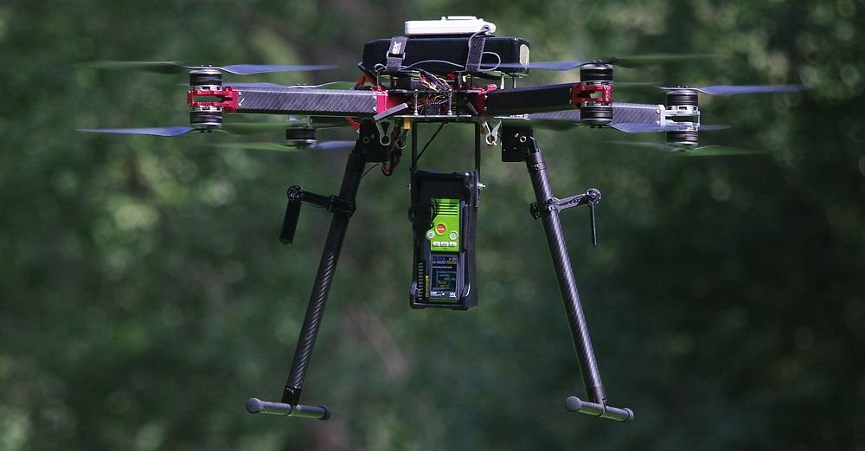
About These Softwares
Ardupilot:
Open source software suite
Quadcopters, VTOL and more
Cross platform
Over 10 years of development and improvement
PX4:
Also open source
Works with QGC and MAVLink (Also available in GitHub)

Slide 10
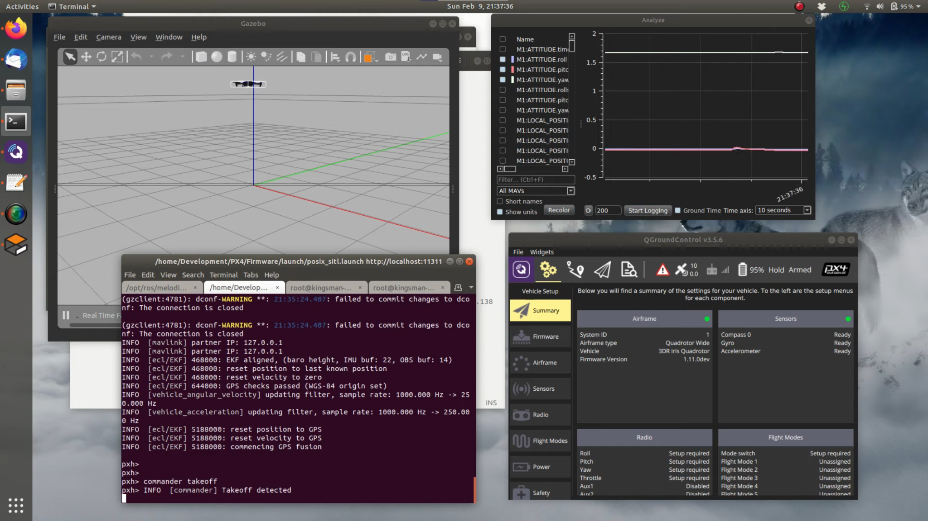


Slide 11
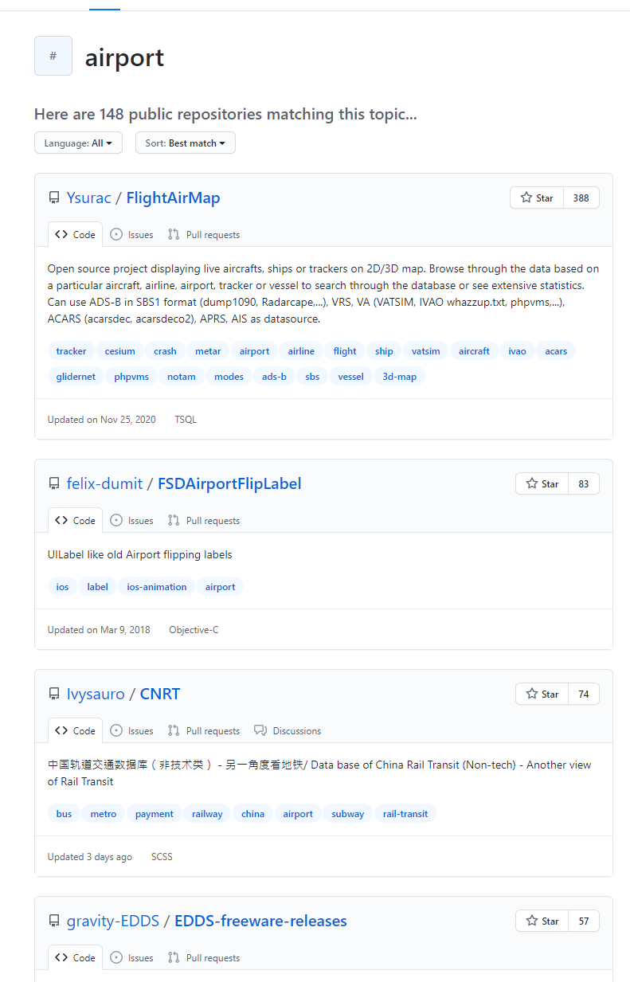
Aviation Services Engineering
Logistics and Facility Management and more

Slide 12
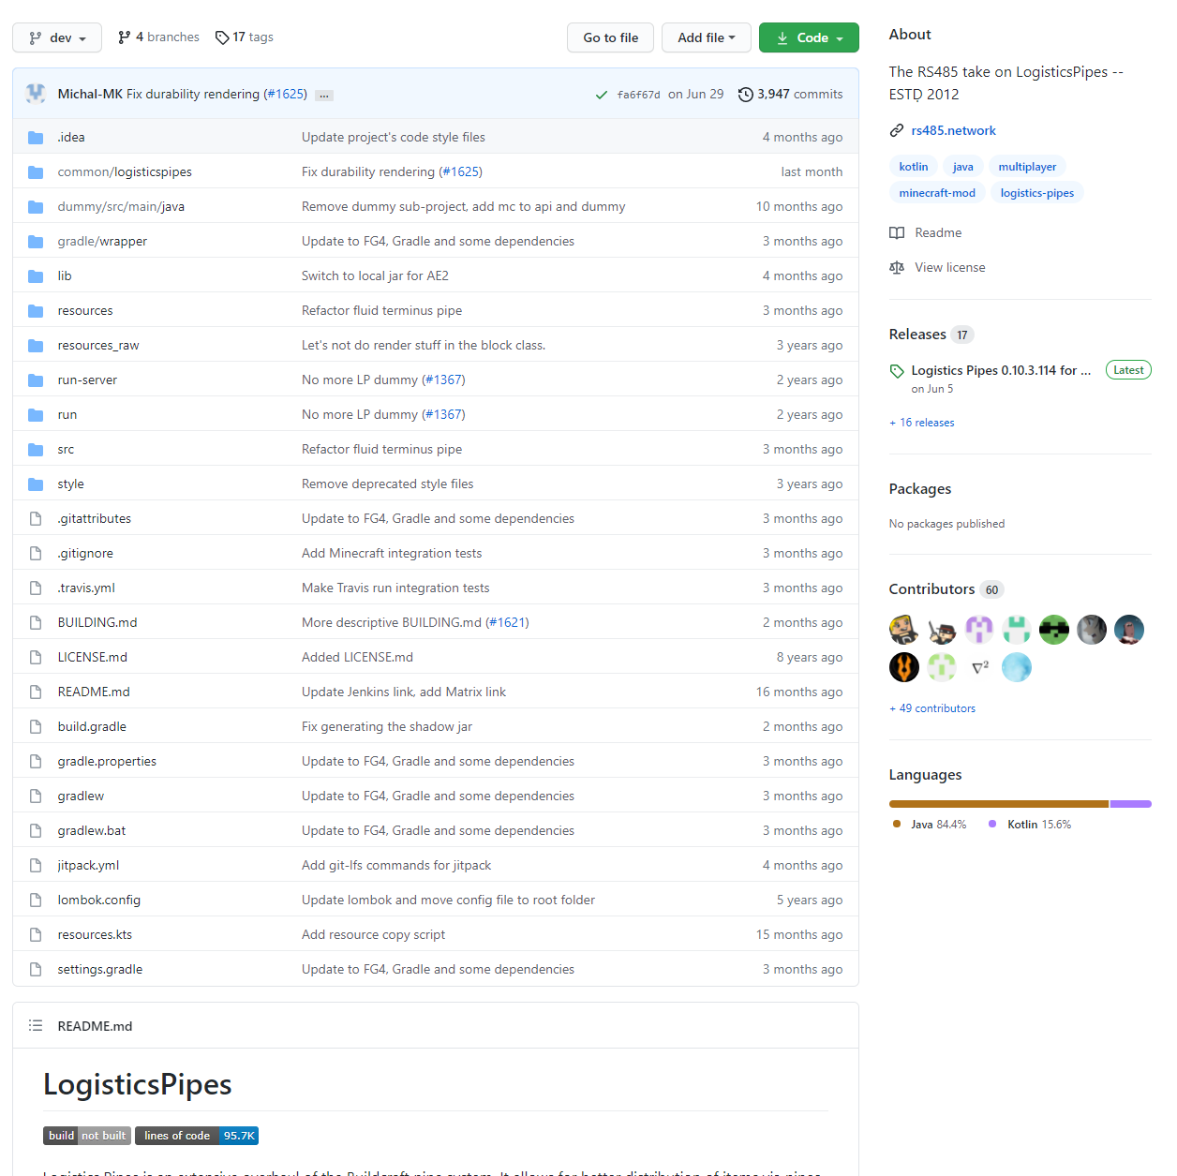
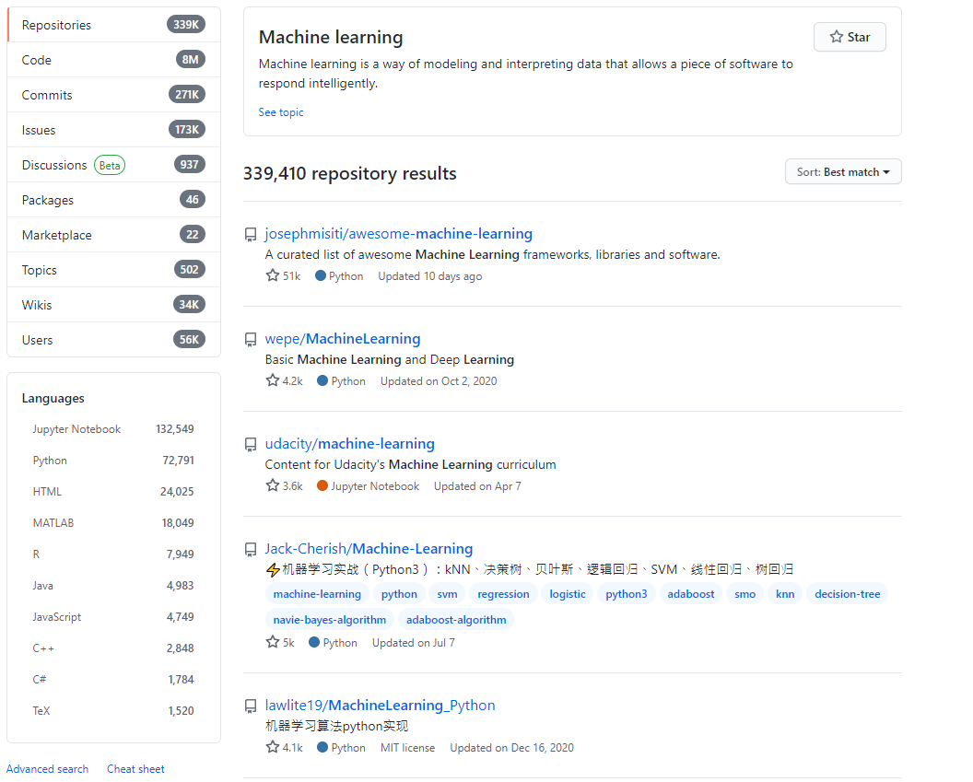
Logistics and Facility Management
Machine learning for data analysis
Data analysis resources
System modelling and simulations
Logistical models
Faster analysis
Potential extra self-learning for students
Extremely beneficial to their careers

Slide 13
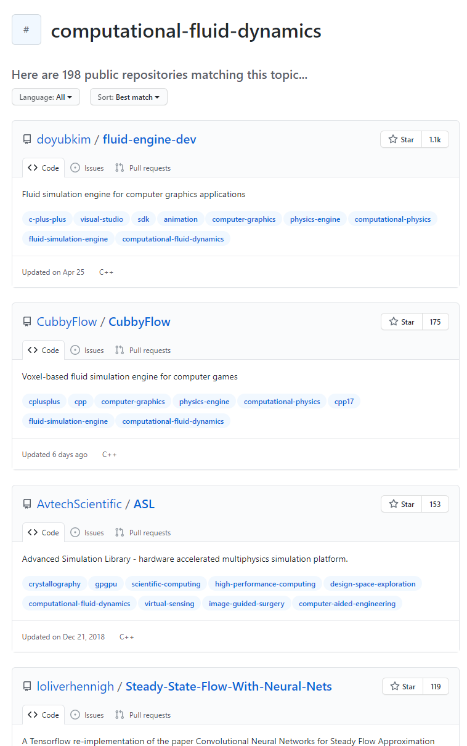
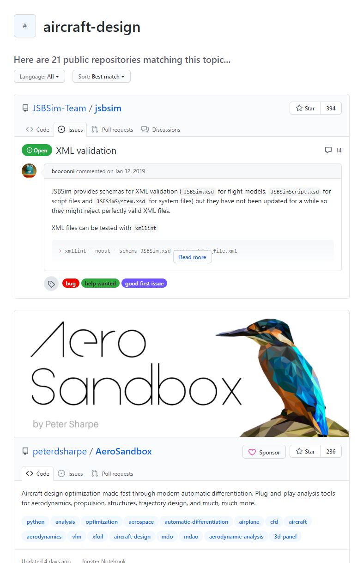
Aeronautical Engineering
Material, aircraft designs, CFD and more

Slide 14
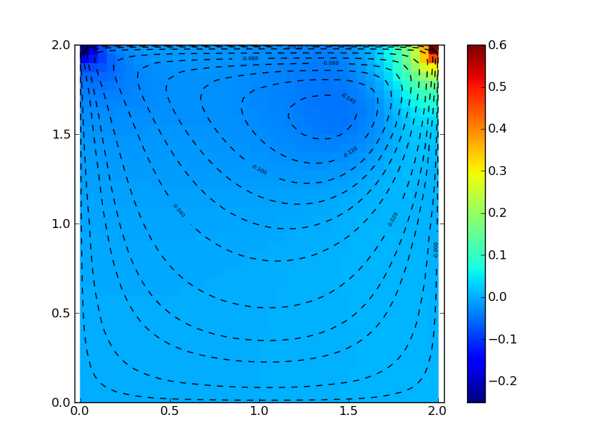
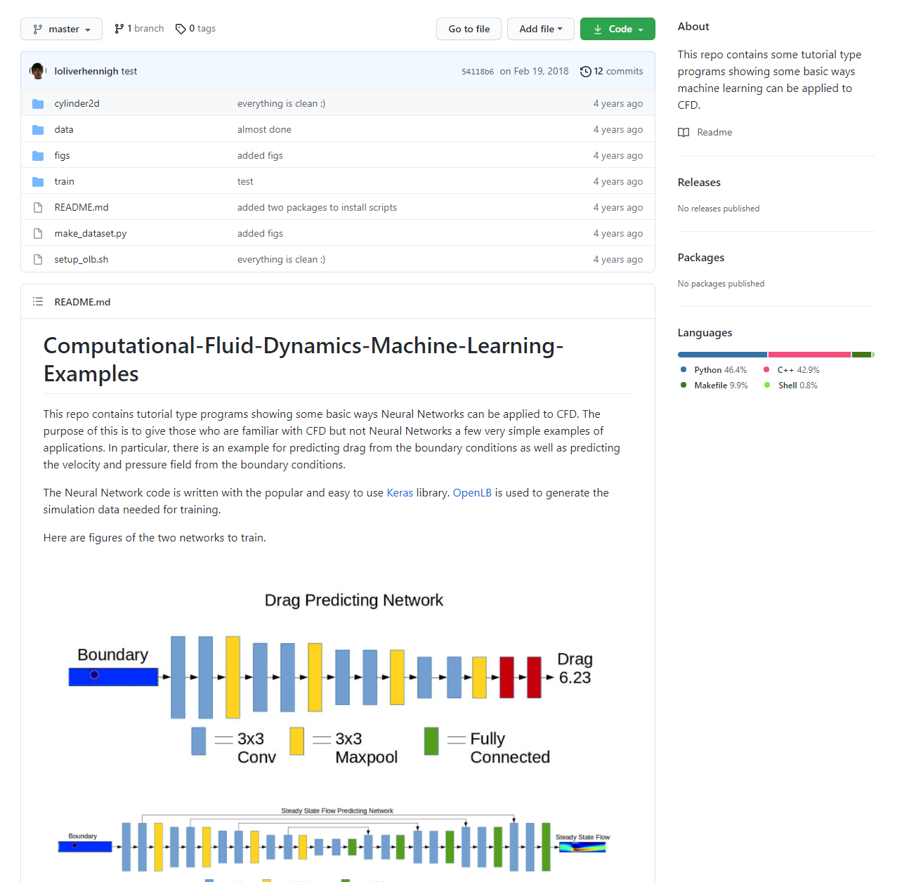
CFD Python
CFD and Machine Learning
Full course for CFD Python
Course Materials (Lectures and videos)
Software resources
Making use of ML
Showing how neural networks can be applied to CFD

Slide 15
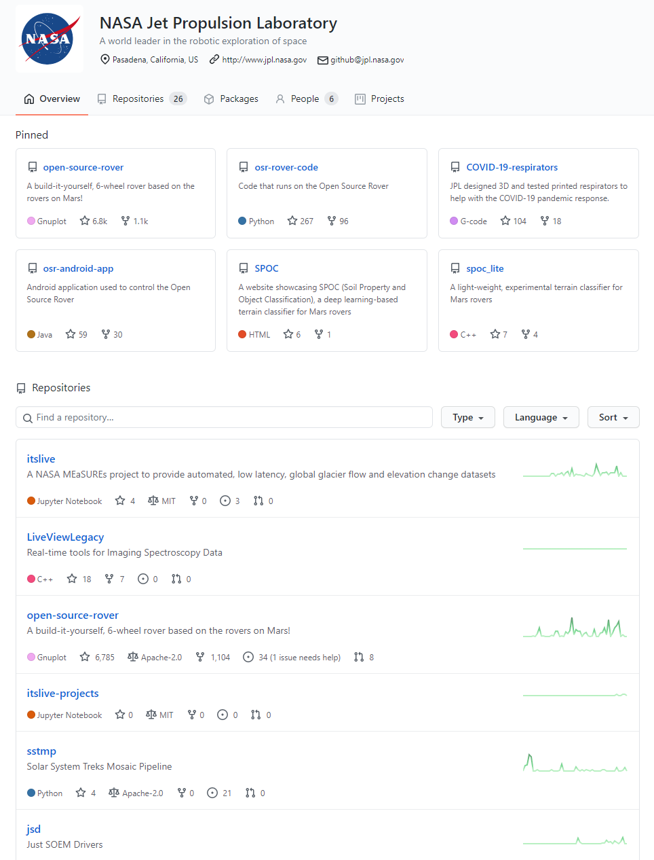
Aircraft Maintenance
Propulsion, NDT and more

Slide 16
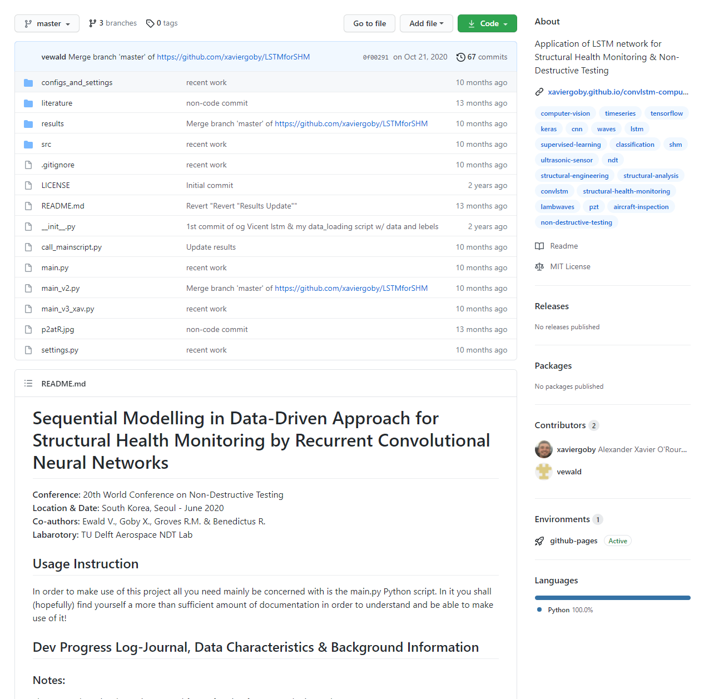
Example on NDT
Resources on the whole conference
20th World Conference on Non-Destructive Testing
Documentation and software resources
Applying LSTM to NDT

Slide 17
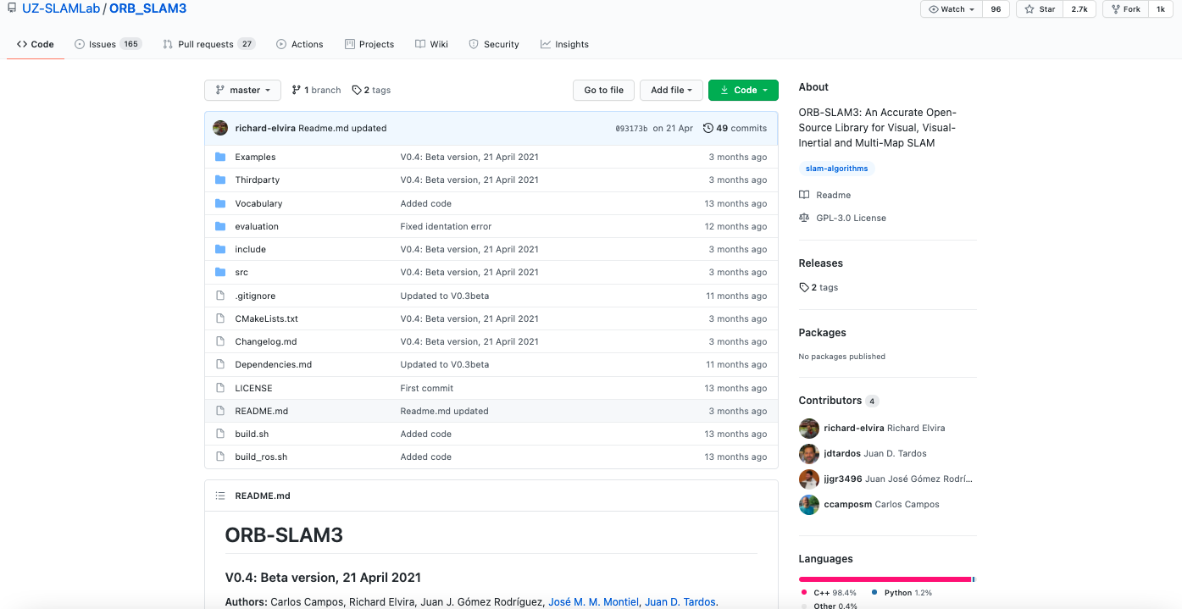
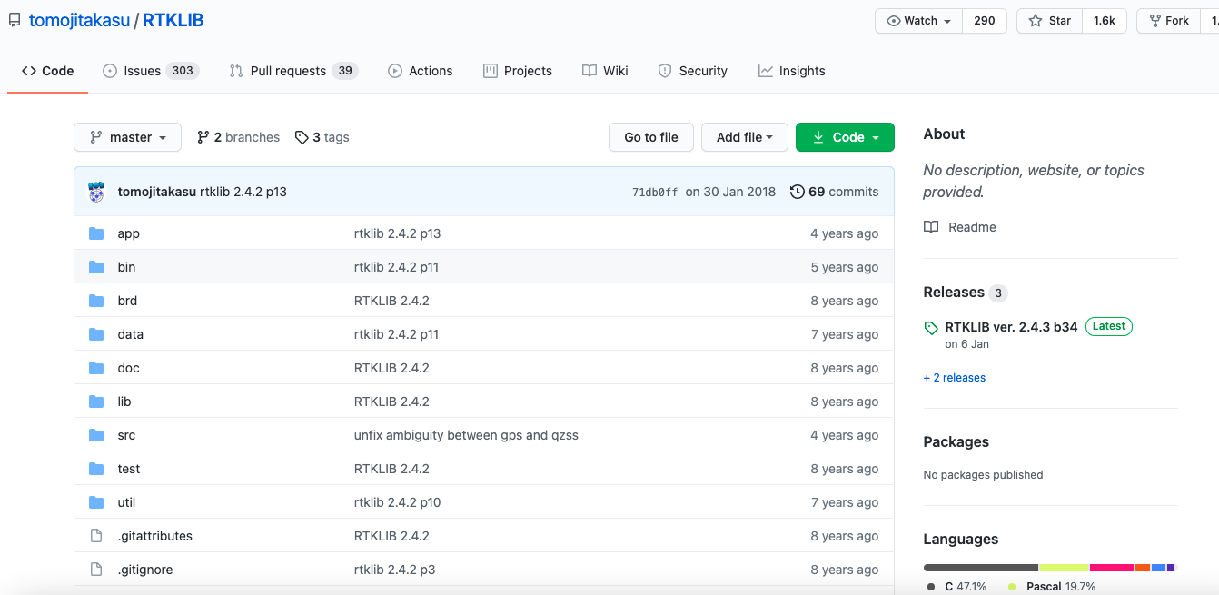
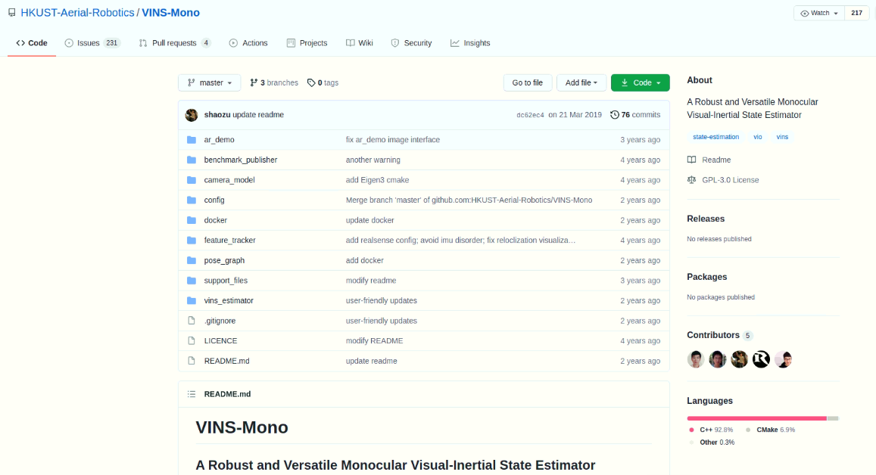
Navigation and Positioning
RTKLIB, VINS, ORB_SLAM3, ROS and more

Slide 18
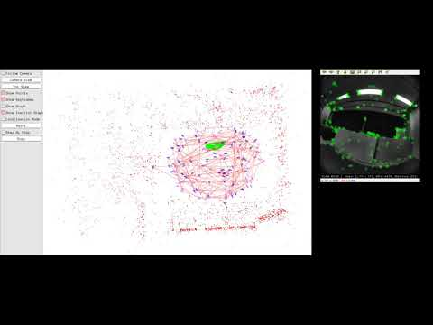
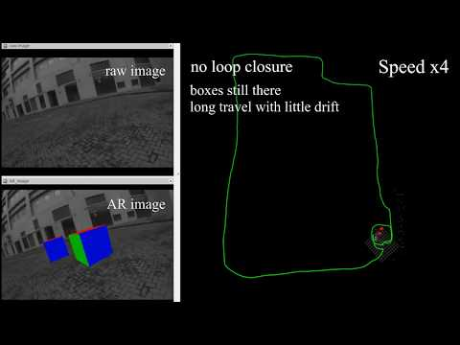
Examples

Slide 19
Examples by our student using GitHub
Run: ORB_SLAM3
Run: VINS Mono

Slide 20
GitHub Facilitated Projects

Slide 21
Achieved using GitHub Materials

Slide 22
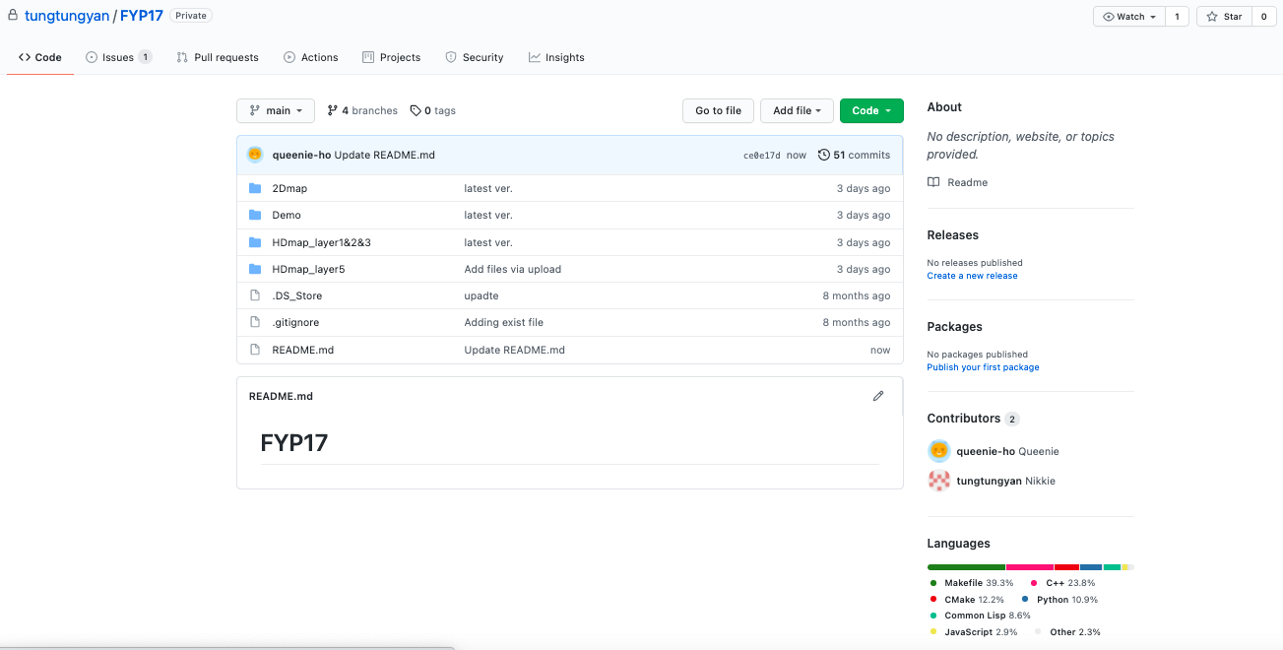

Slide 24
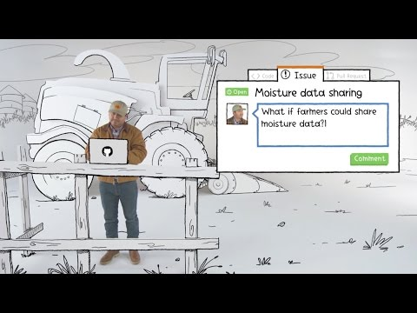

Slide 25

What Will You will Learn and Experience?
Pull Request (Basic Features)
Allowing leaders to double check modifications done by teammates
Code Synchronization (Version Control on Web, VS, MATLAB etc)
Ensuring everyone is working on the latest code version
Self-learning using GitHub resources
Look for interesting issues on GitHub

Slide 26
For Your Career

Slide 27

GitHub Facilitated Job Hunting
A online digital profile for students
Indicating interests
Show past work
Roadmap of students’ development career
Let people know that you are looking for a job
During job hunting
Better first impression
Better understanding
Appears more enthusiastic
Notes:
https://www.gousios.gr/pub/dev-profiles.pdf

Slide 28
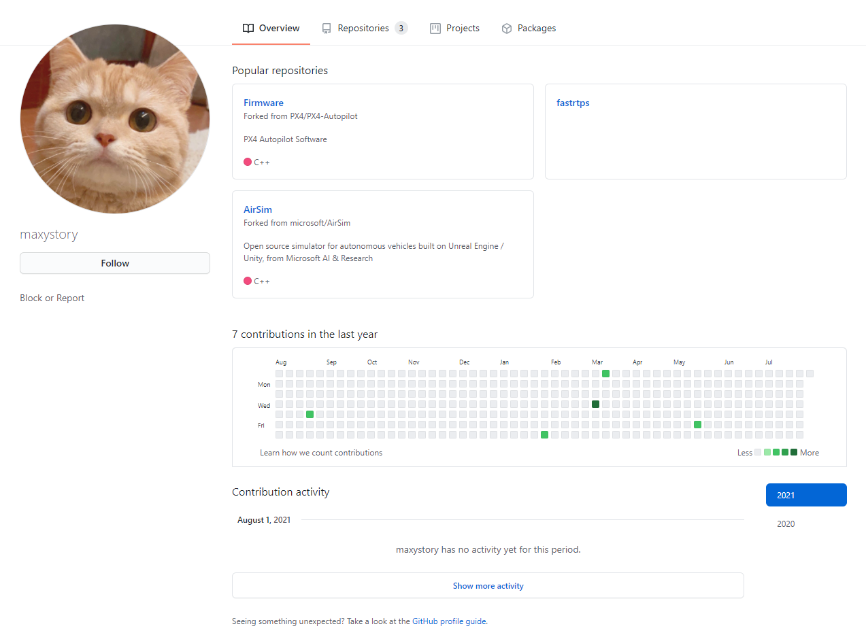
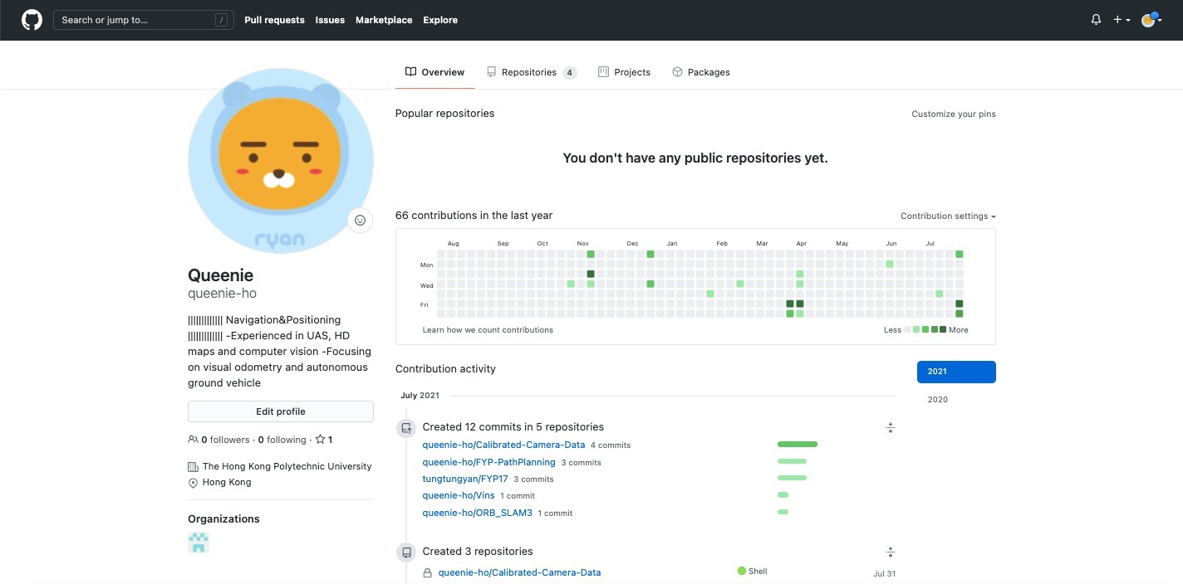
Develop Personal Profiles Starting from AAE UG
Notes:
https://github.com/maxystory

Slide 29
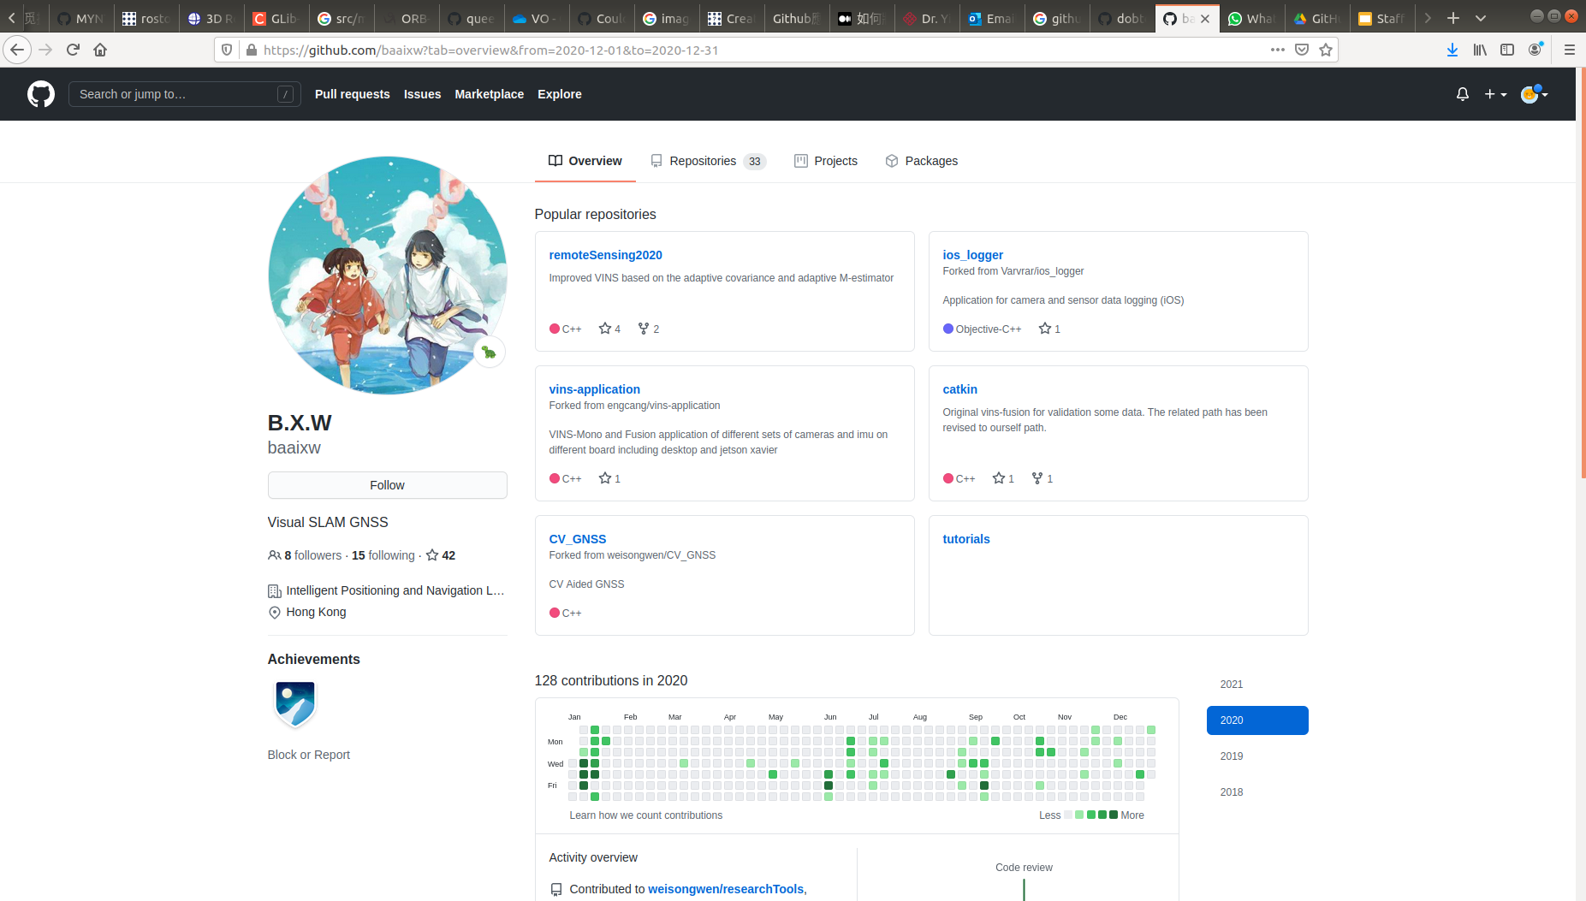
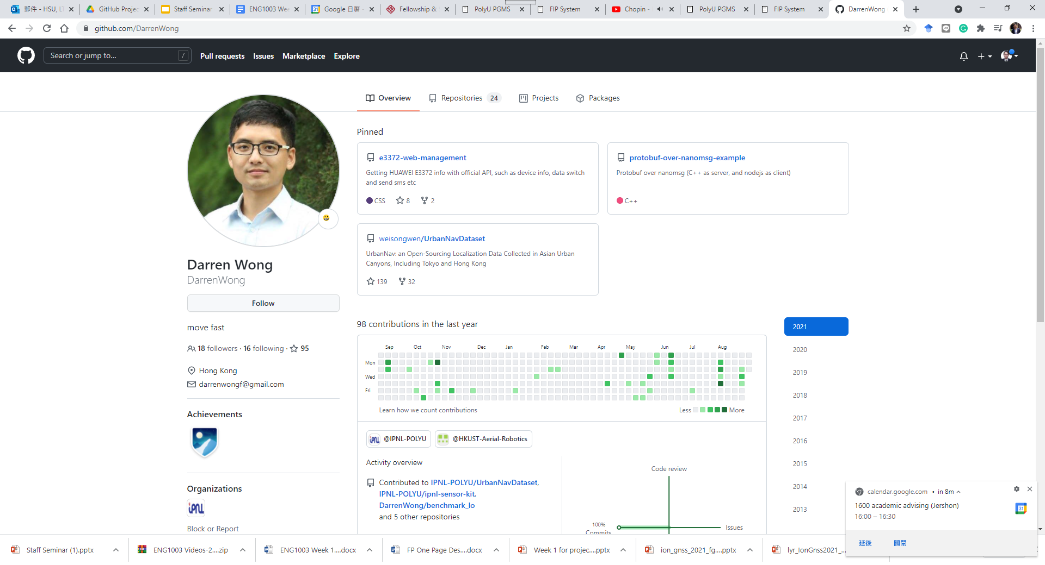
Up to Phd Studies
Notes:
https://github.com/weisongwen

Slide 30
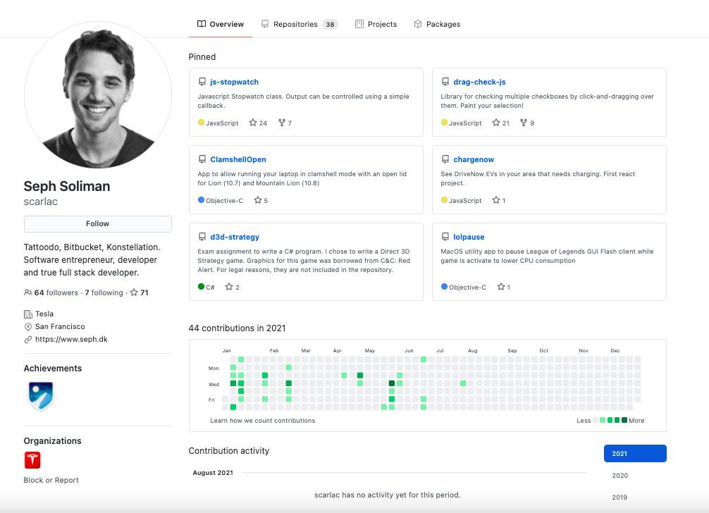
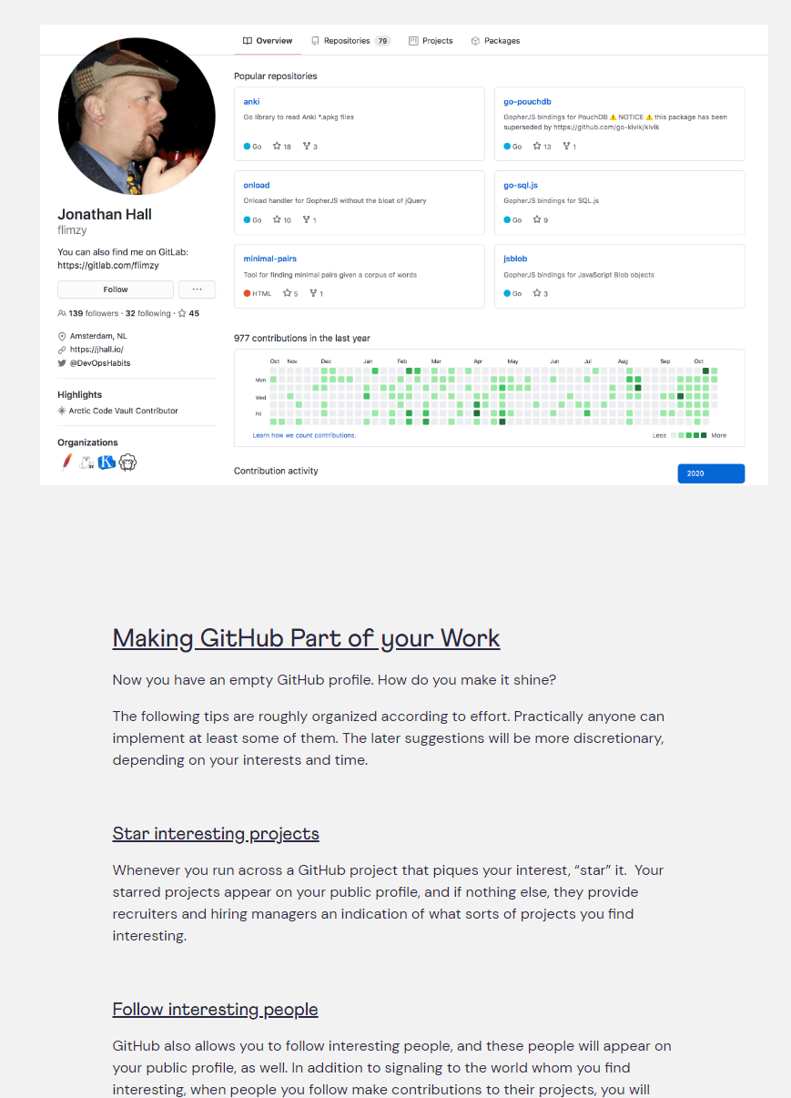
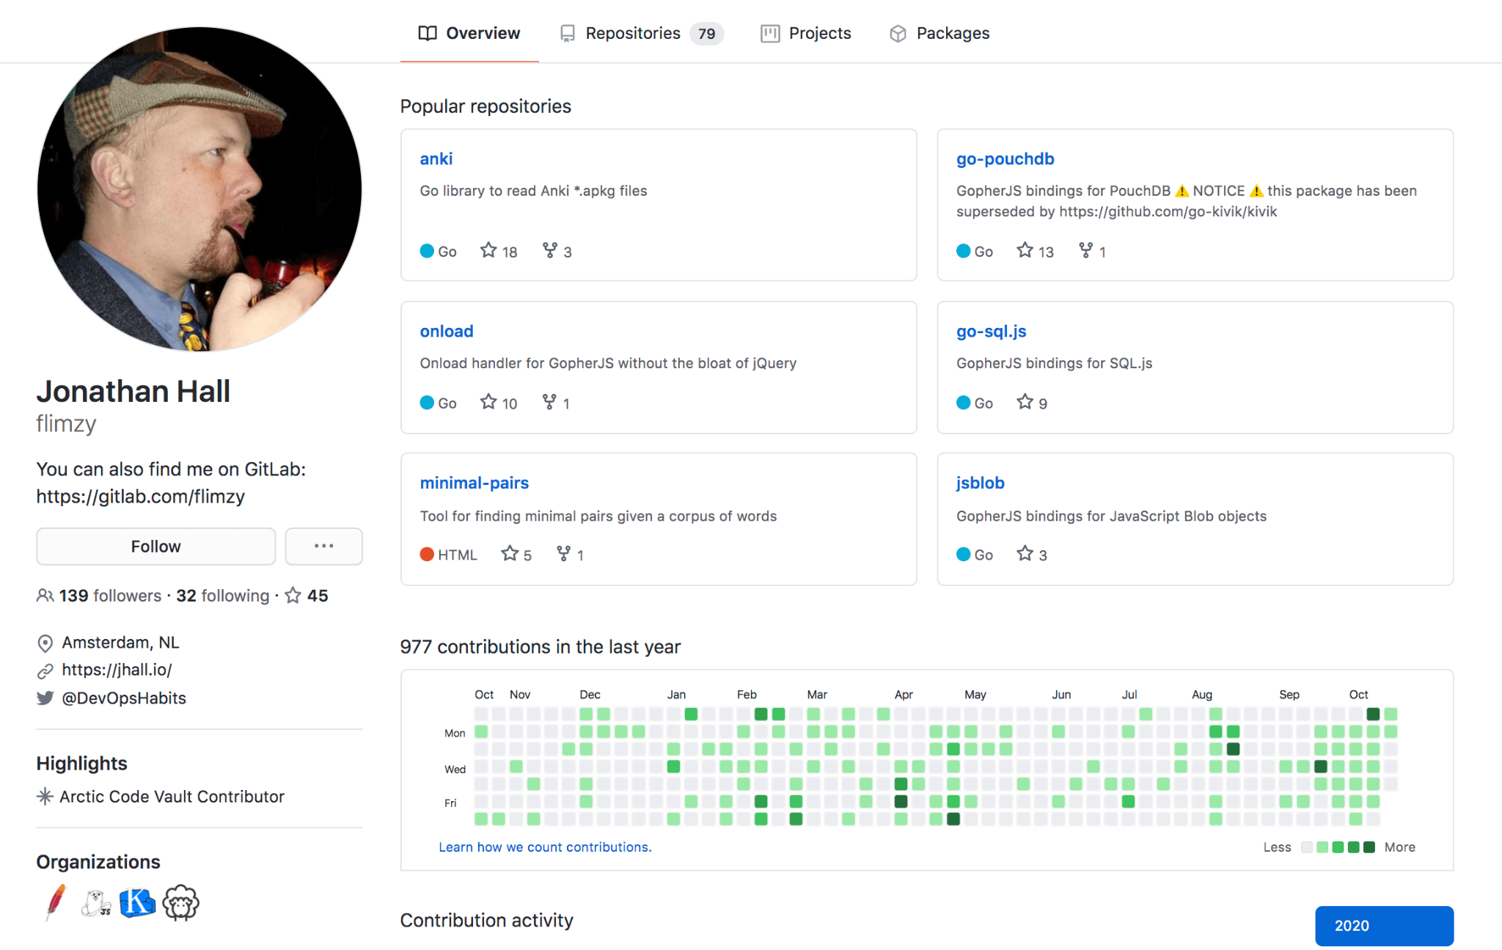
Notes:
https://orange-quarter.com/using-github-to-land-a-job/

